Slide 1
Parking violations and Collisions in NYC Lakshmikar Reddy Polamreddy Jatin Kayasth Juju Ren

Slide 2
Agenda
Motivation
Research questions
Sourcing the data
Understanding the data
Creating database schema and creating tables in PostgreSQL
EDA of Parking violations data
EDA of Collisions data
Identifying the relation between parking violations and collisions, if any
Challenges
Conclusions
Way Forward
Questions?

Slide 3
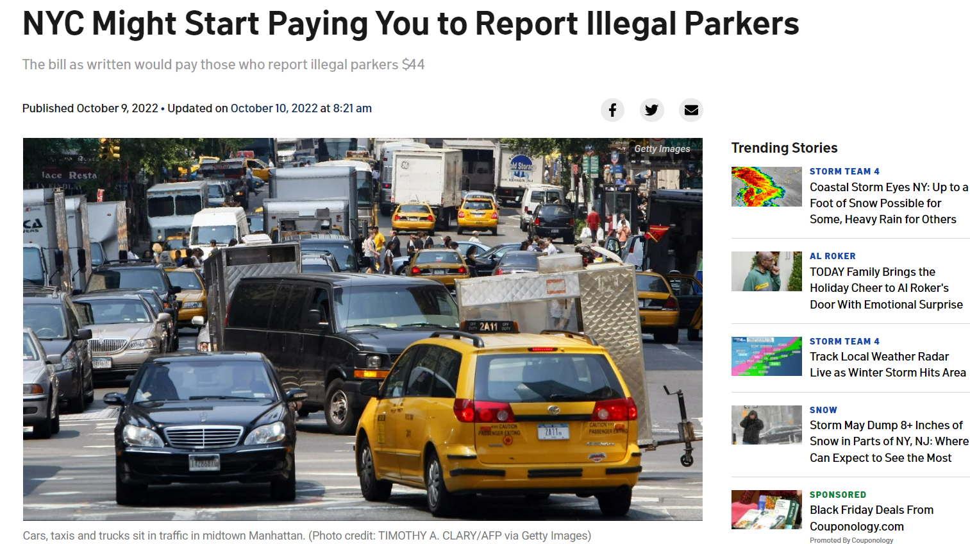
Motivation:
Safety risks associated with illegal parking . For example, parent pushing a stroller or a person in a wheelchair who can’t get by on the sidewalk because of illegally parked cars
A new proposal to increase city parking enforcement by incentivizing New Yorkers to report illegally parked cars is gaining a lot of attention crosswalks and school entrances or exits
https://www.nbcnewyork.com/news/local/nyc-bill-would-pay-people-to-report-drivers-parking-illegally/3899757/

Slide 4
Research Questions
What kind of vehicles are involved more parking violations?
Are most of the violators from New York State or from other states?
Are parking violations more common among unregistered vehicles?
Street-wise analysis of accidents in NYC
Month-wise analysis of accidents in NYC
Borough-wise analysis of number of persons injured and number of persons killed in collisions
What is the major reason for accidents in NYC
Identifying the relation between parking violations and collisions

Slide 5
Sourcing the data:
Parking violations data for the year 2022 is available as a csv file in NYC Open data in this link: https://data.cityofnewyork.us/City-Government/Parking-Violations-Issued-Fiscal-Year-2022/7mxj-7a6y
Parking fines against violation code are available in this website: https://www1.nyc.gov/site/finance/vehicles/services-violation-codes.page Data has been collected from this website by means of web scraping
Vehicle collisions/crashes data for year 2022 is available as a csv file in NYC Open data in the below link https://data.cityofnewyork.us/Public-Safety/Motor-Vehicle-Collisions-Crashes/h9gi-nx95
Understanding the data:
Parking violations dataset: 15 million use cases and 43 attributes
Collisions dataset: 2 million use cases and 29 attributes
Fines dataset from web scraping: 92 use cases and 3 attributes

Slide 6
Database schema:
Created below schema and tables in PostgreSQL for parking violations dataset
Parking Violation details
Summons number (P-key)
Issue date
violation code
violation location
violation time
time first observed
violation county
house number
street name
date first observed
days in effect
from hours in effect
to hours in effect
violation post code
violation description
no standing or stopping violation
hydrant violation
double parking violation
Issuer code (F-key)
plate id (F-key)
violation code (P-key)
Issuer details
Issuer code (P-key)
Issuer precinct
Issuing agency
Issuer command
Issuer squad
fines data
violation code (P-key)
violation description
fine amount
vehicle details
plate id (P-key)
registration state
plate type
vehicle expiration data
vehicle color
unregistered vehicle
vehicle body
vehicle make

Slide 7
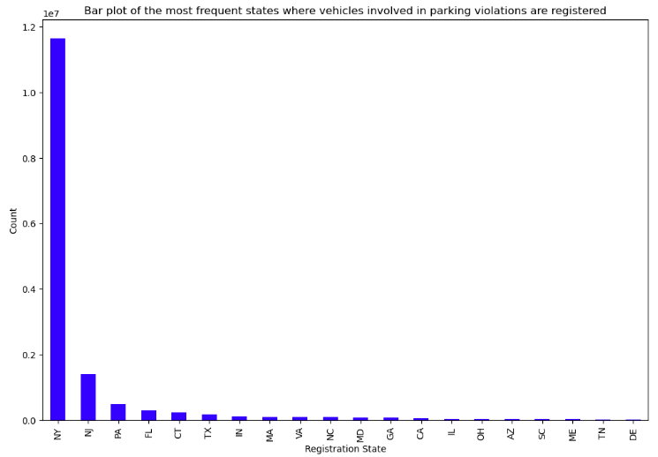
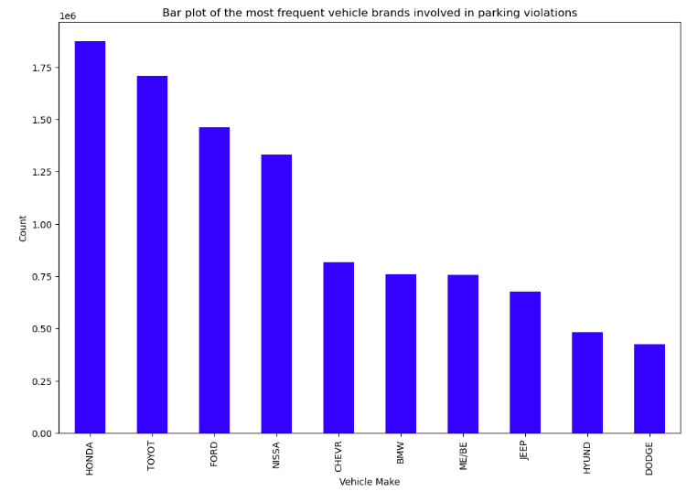
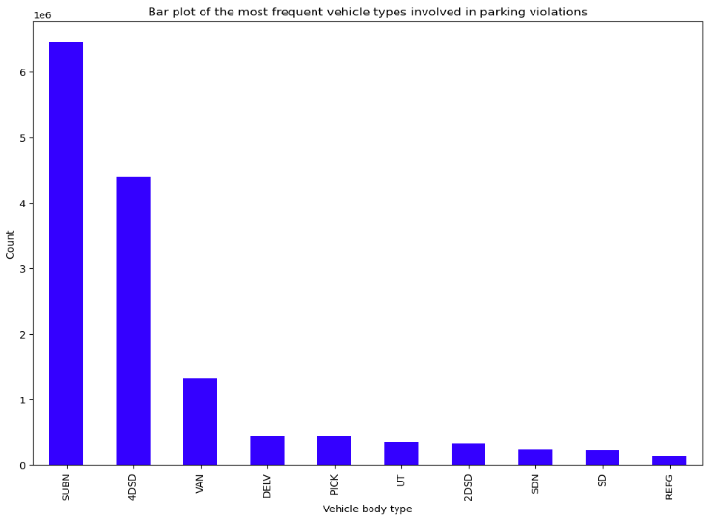
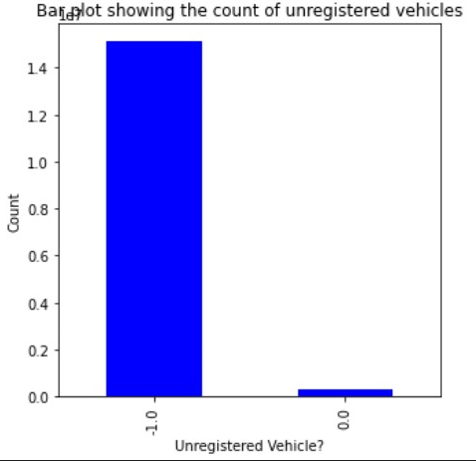
EDA of Parking violations data:
Honda, Toyota, Ford and Nissan brands accounted for 41.3% of the parking violations in NY
More than 75% of the vehicles involved in parking violations belong to NY state.
NY is followed by NJ which is bordering NY
Vehicle types SUBN and 4DSD are involved in 70% of the parking violations followed by VAN. SUBN refers to suburban vehicles and 4DSD refers to four-door sedan vehicles
Unregistered vehicles account for 2% of the parking violations

Slide 8
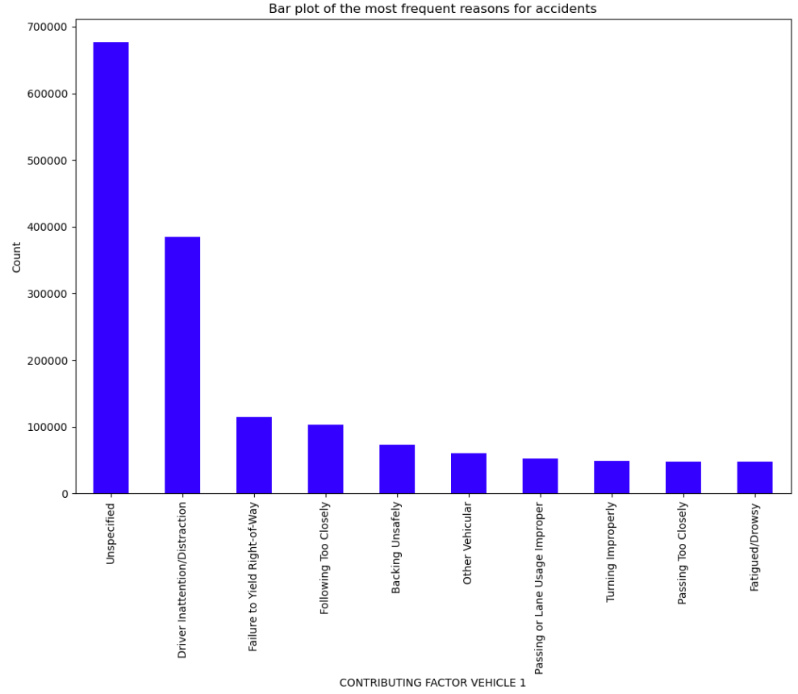
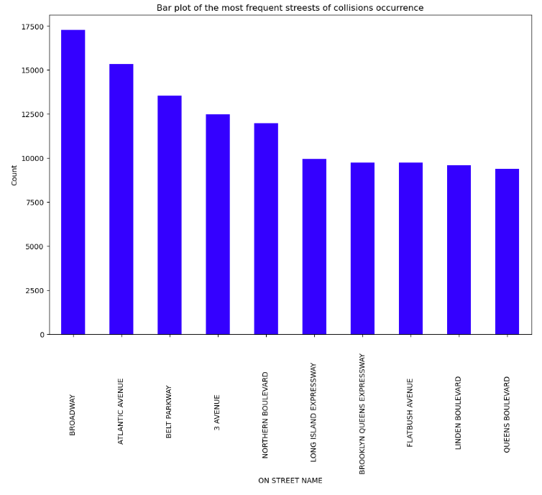
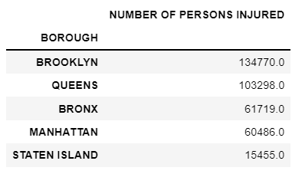
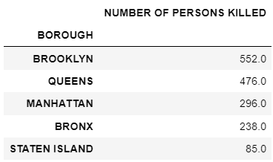
EDA of Collisions data:
Driver Inattention/Distraction is the major reason for accidents
Highest number of collisions occurred on Broadway street
The number of persons injured and the number of persons killed are the highest in Brooklyn followed by Queens

Slide 9
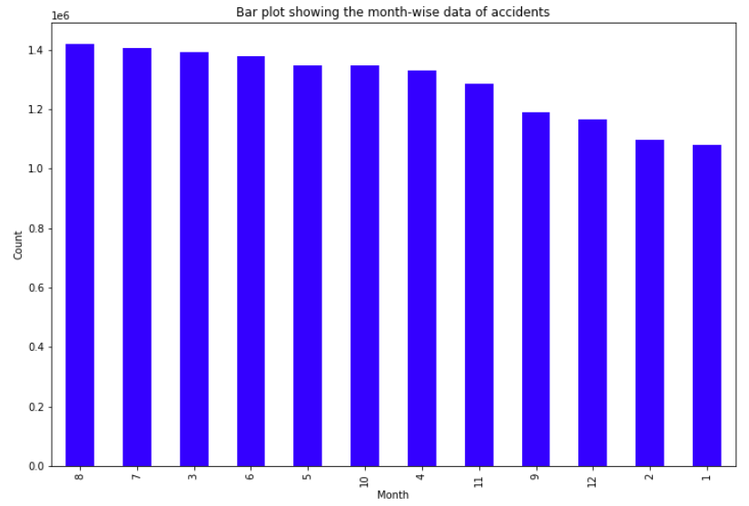
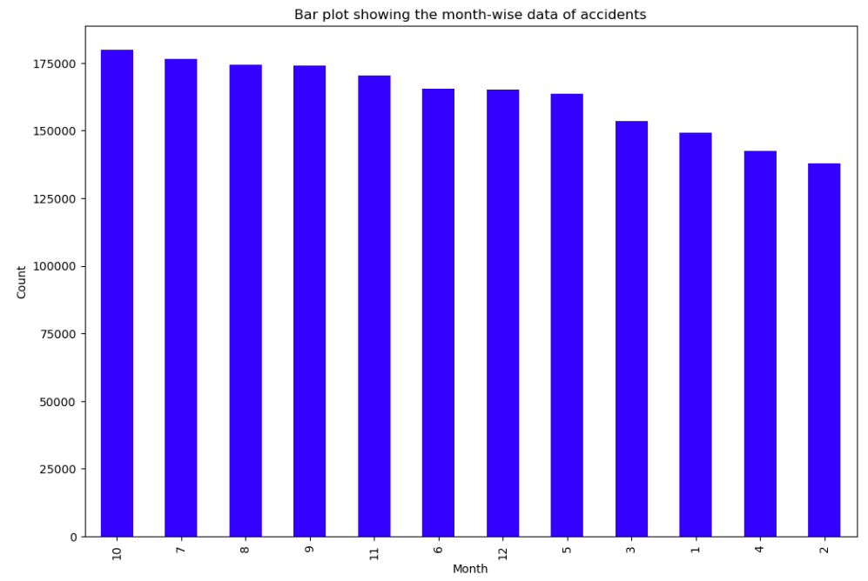
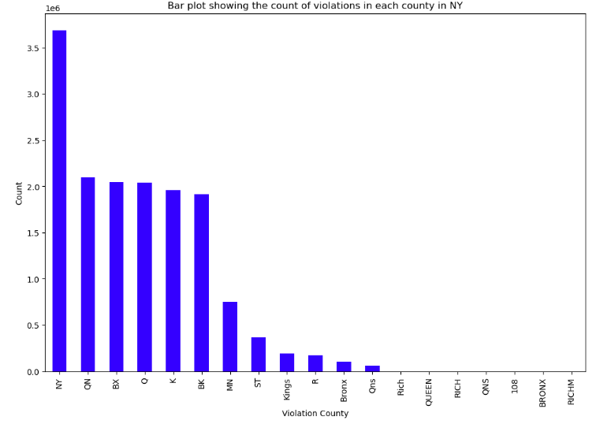
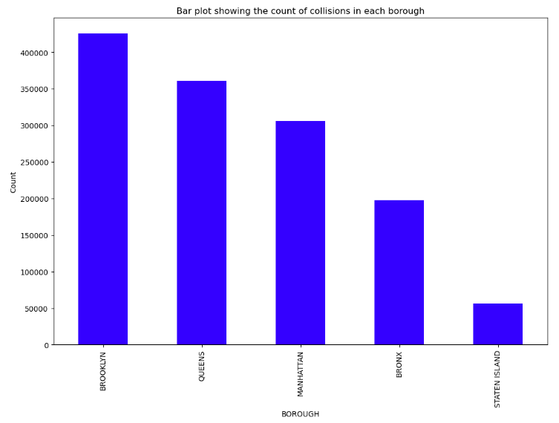
Relation between Parking violations and collisions:
October accounts for the highest number of accidents and February accounts for the least number of accidents in NYC
Most number of accidents(31.6%) occurred in Brooklyn borough followed by Queens
Summer months have witnessed more number of parking violations
Most of the violations accounting for 23.9% occurred in NY county that refers to Manhattan borough

Slide 10
Challenges:
Issue in getting the latitude and longitude coordinates using APIs
Conclusions:
Most parking violations in Manhattan
Most accidents in Brooklyn and Queens
Way forward:
Out of total unregistered vehicles, what percentage of vehicles is involved in parking violations.
Major reason for collisions: Unspecified in the data

Slide 11
Questions?

Slide 12
Thank you!

